Slide 1
Carcommerce (ONLINE AUTOMOTIVE MARKETPLACE)
NISANTH ASWIN S
19ISR038
FRONT END TECHNOLOGIES
M.Sc – SOFTWARE SYSTEMS
KONGU ENGINEERING COLLEGE

Slide 2
OBJECTIVE
The main objective of the online automotive marketplace is to provide a comprehensive online platform for customers to conveniently explore, compare, and purchase a diverse range of both new and used cars.

Slide 3
EXISTING SYSTEM:
In the existing system, an user can able to browse the available new cars and will book the favorite one.

Slide 4
PROPOSED SYSTEM:
The main objective of the online automotive marketplace is to provide a comprehensive online platform for customers to conveniently explore, compare, and purchase a diverse range of both new and used cars.

Slide 5
LIST OF MODULES:
NEW CARS
USED CARS
SCHEDULE A TEST DRIVE
BUY CAR PARTS

Slide 6

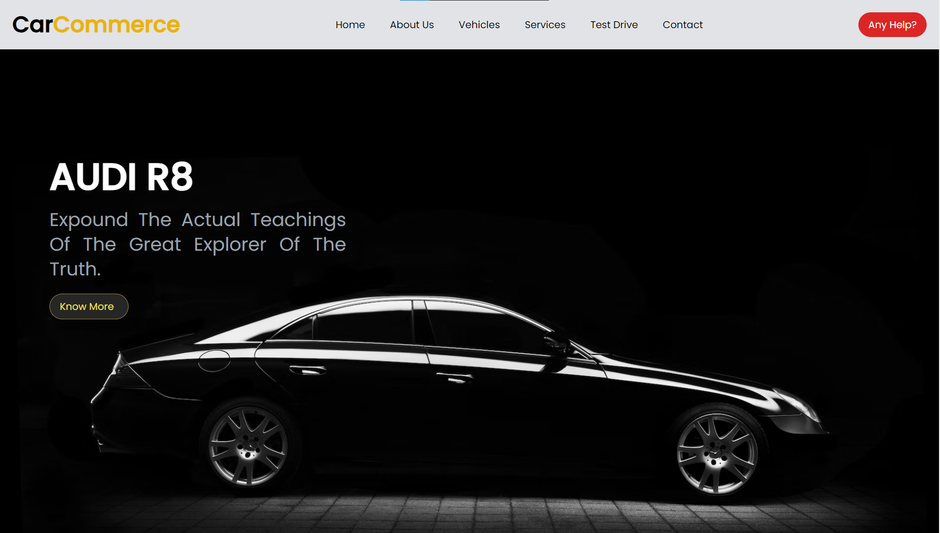
SCREENSHOTS

Slide 7
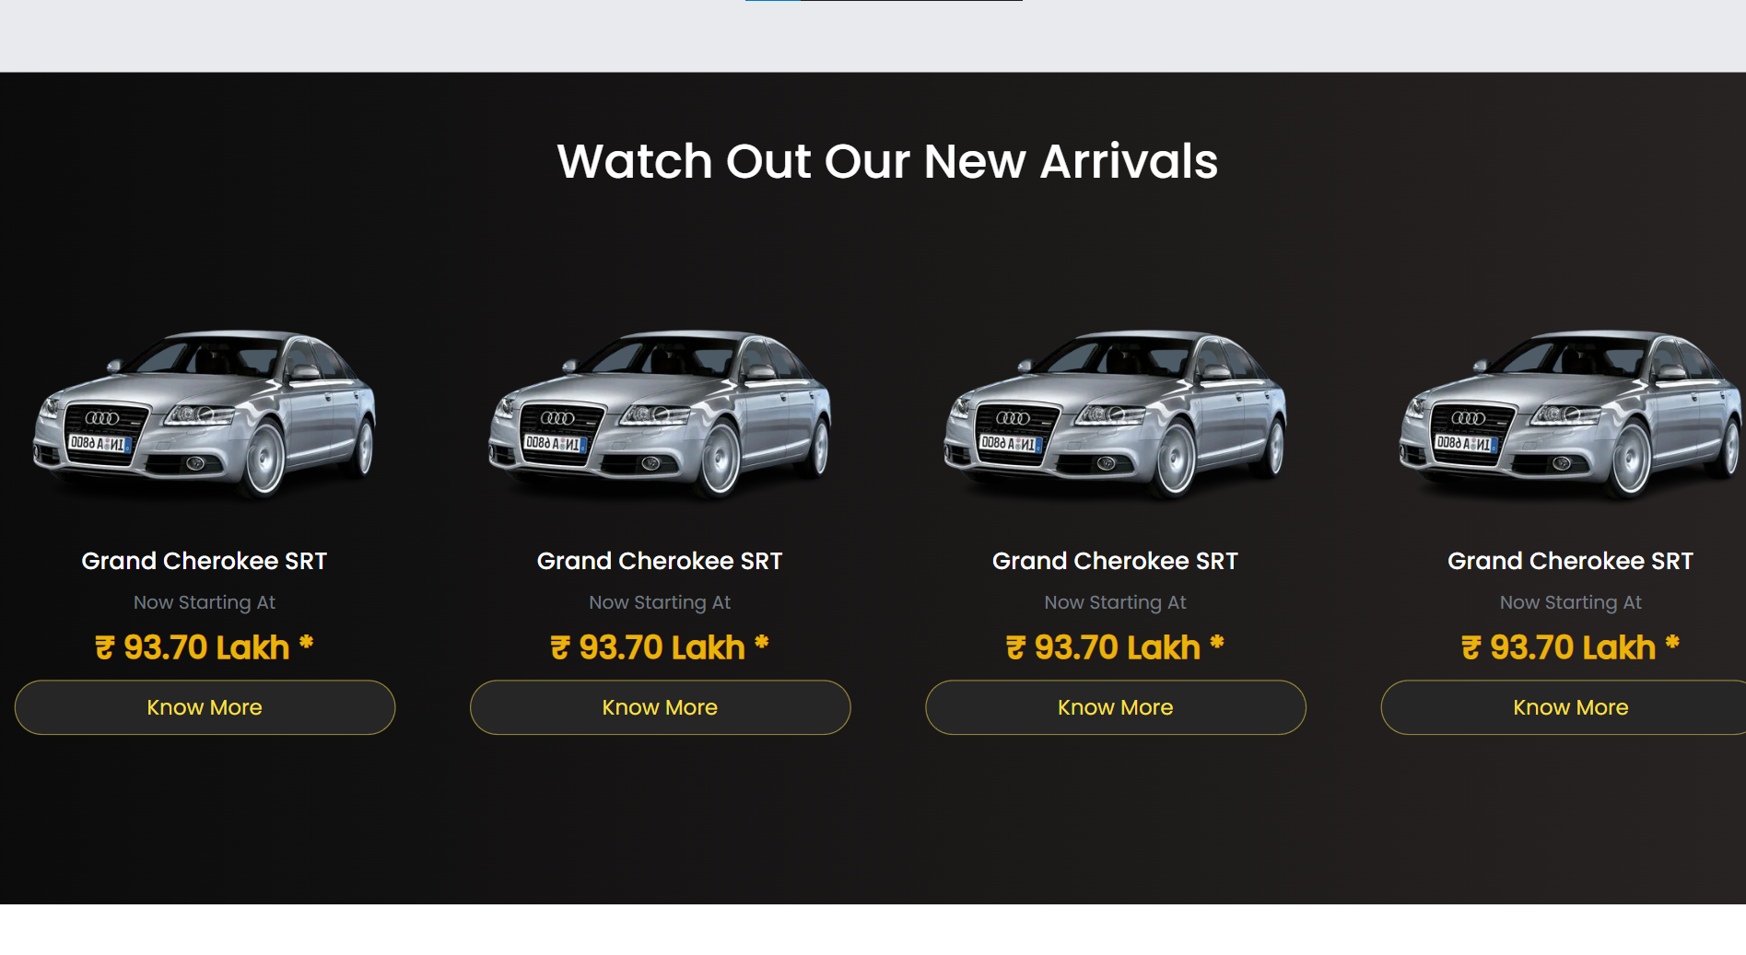
SCREENSHOTS

Slide 8
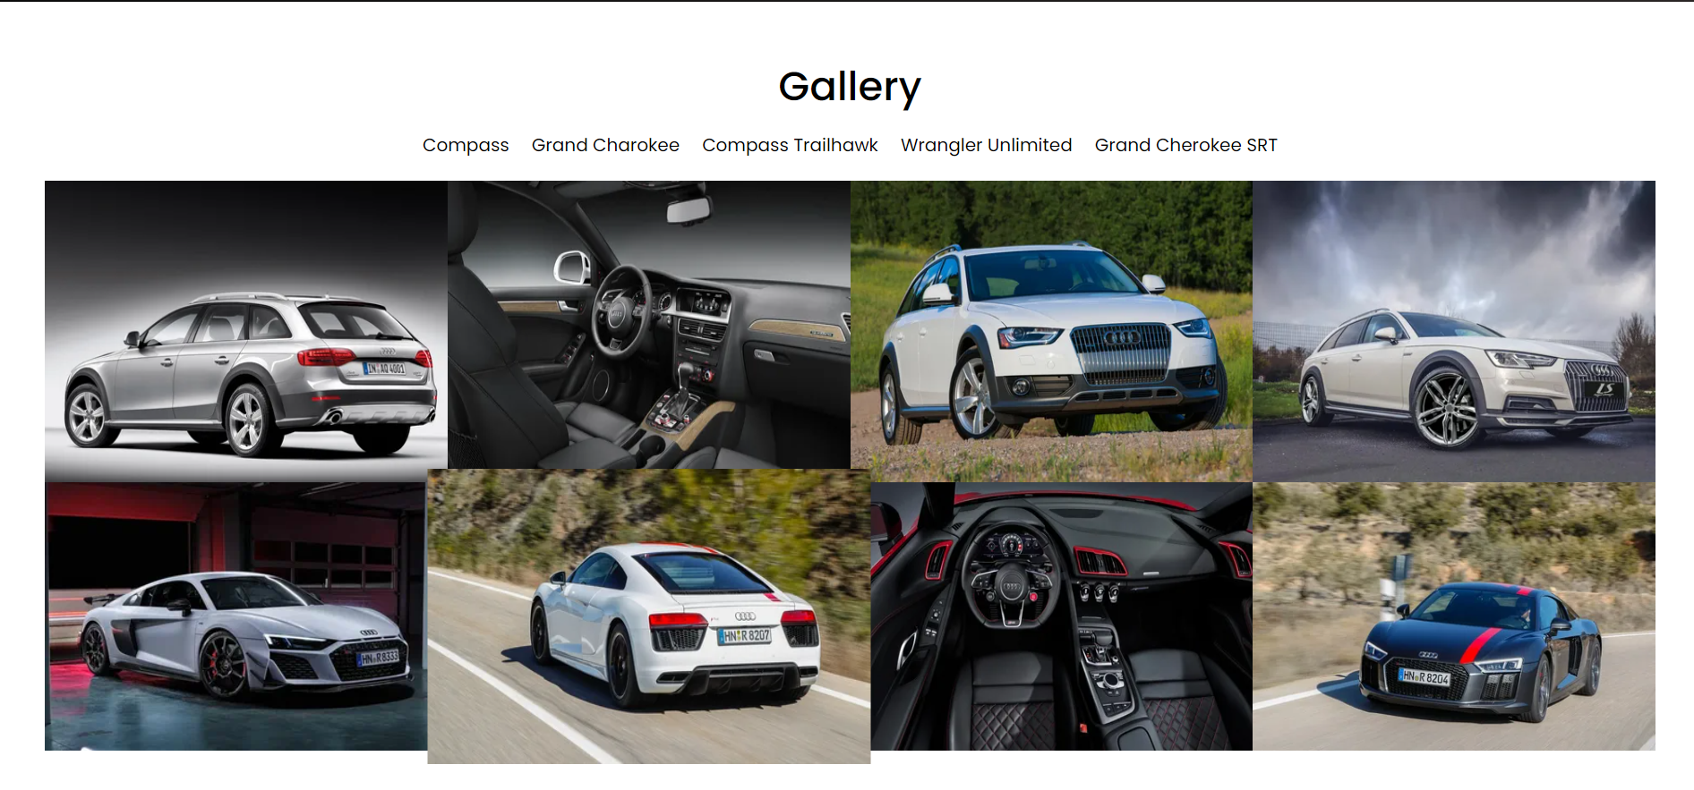
SCREENSHOTS

Slide 9
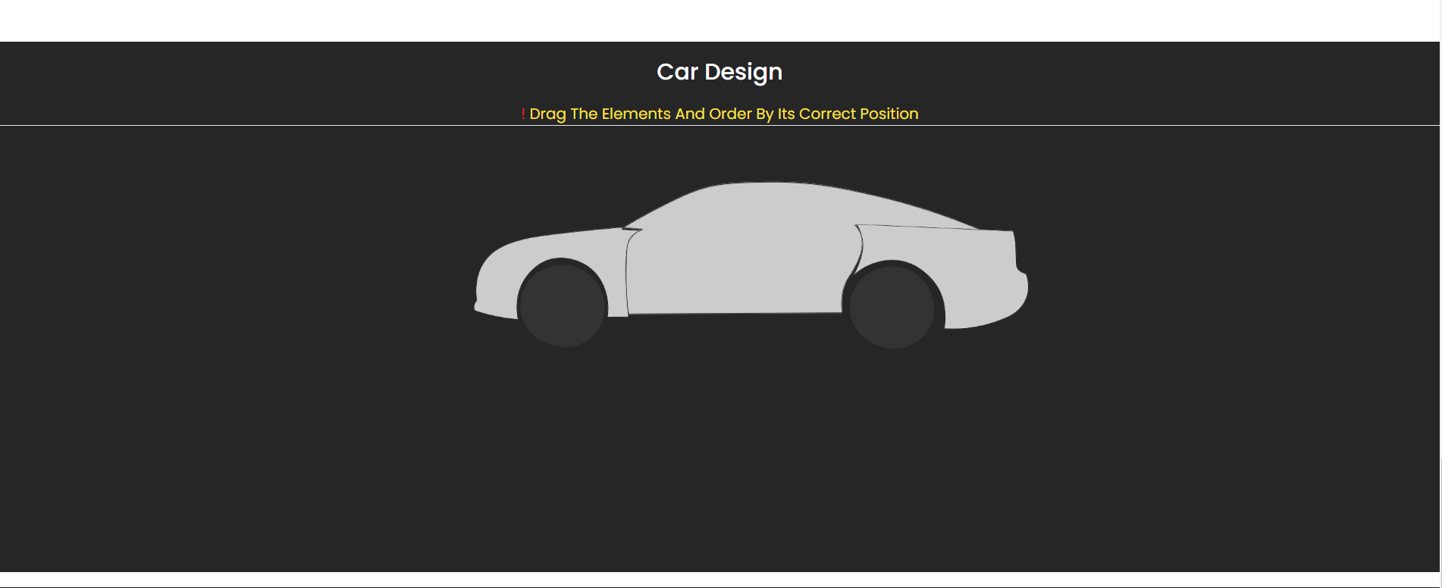
SCREENSHOTS

Slide 10
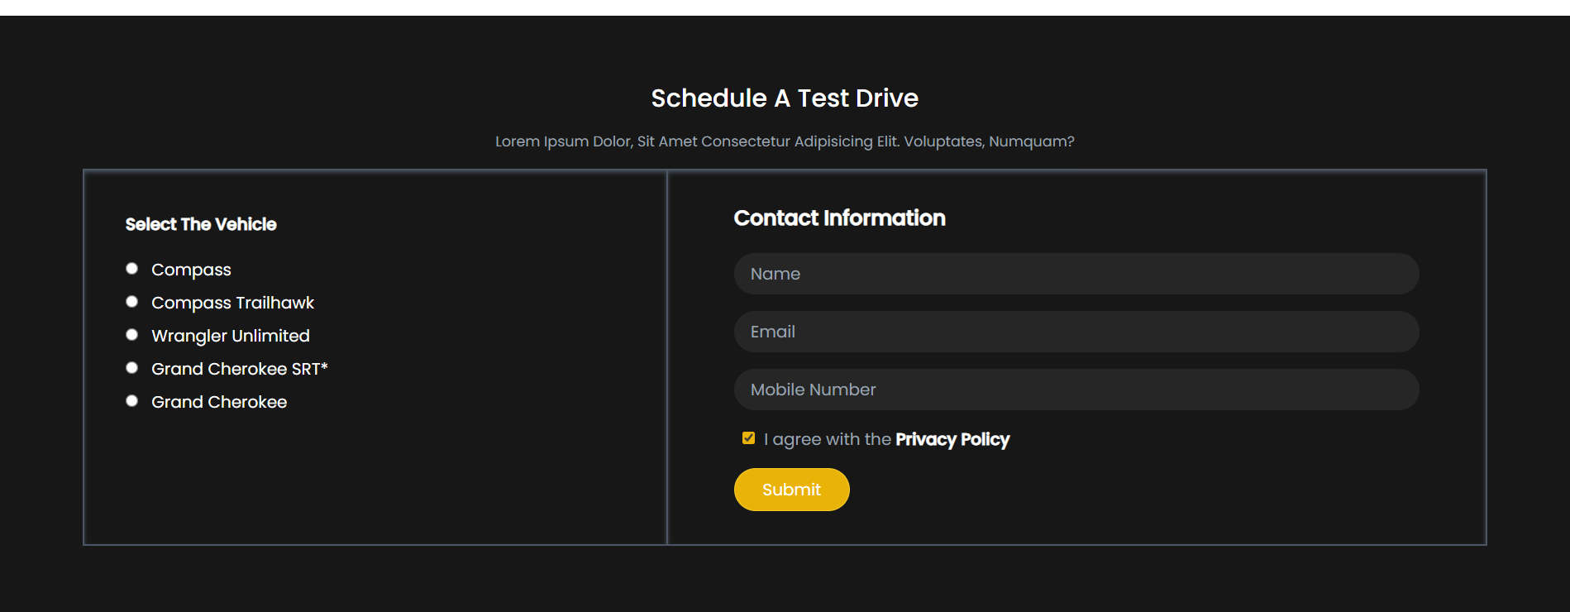
SCREENSHOTS

Slide 11
THANK YOU…

